Slide 1
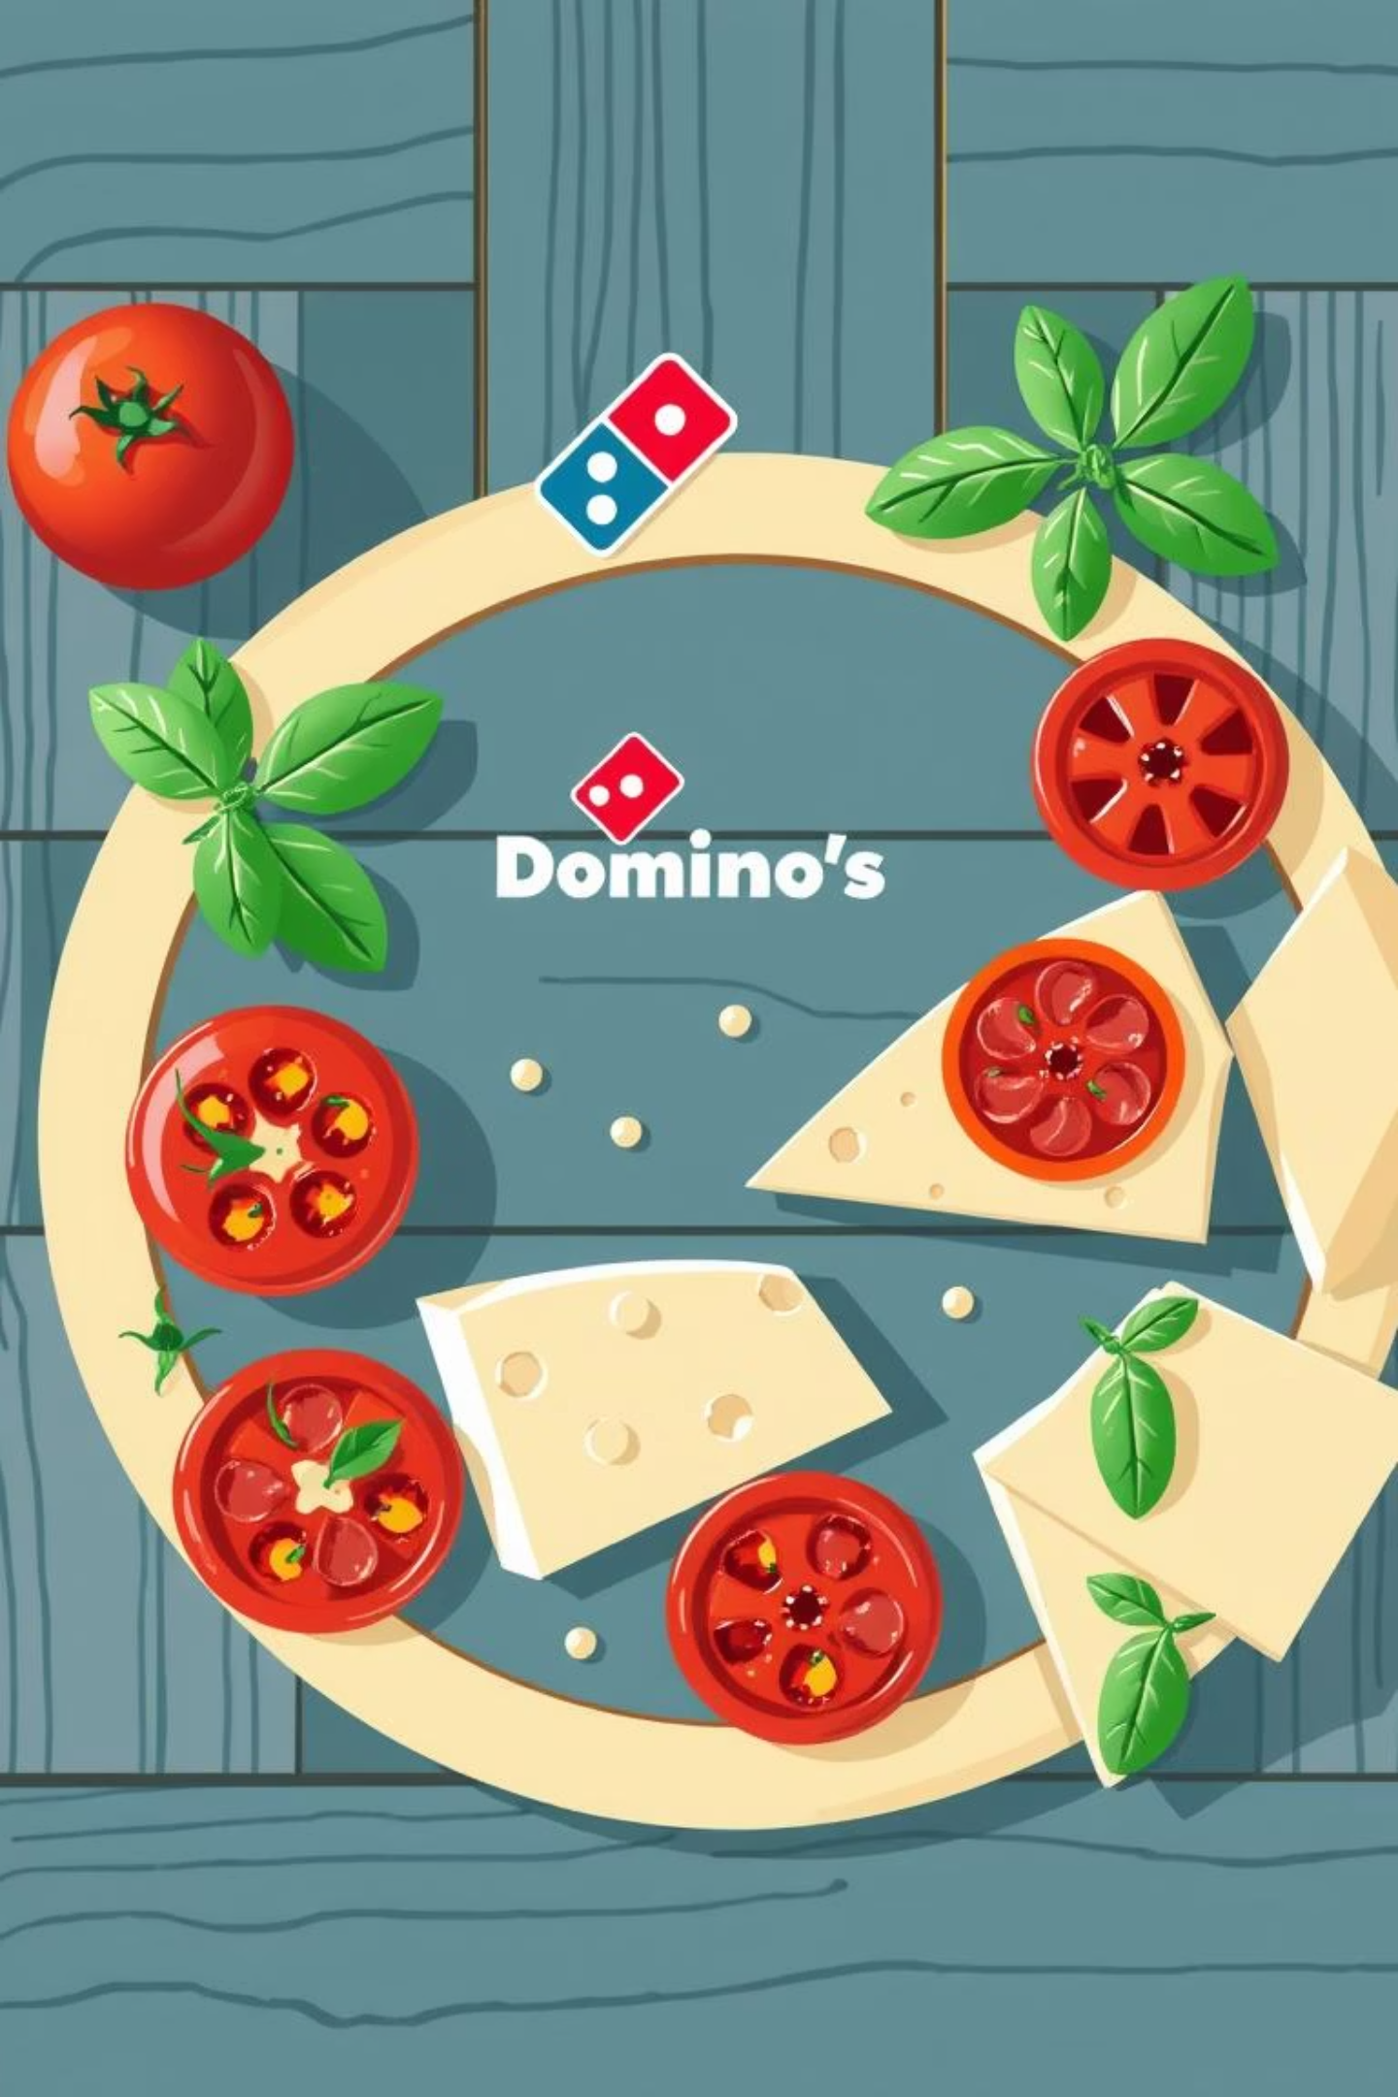
Domino's: Predictive Purchase Order System
Optimizing ingredient procurement through advanced sales forecasting.

Slide 2




Key Business Benefits
Inventory Management
Cost Reduction
Maintain optimal stock levels to meet demand without overstocking, ensuring ingredient freshness and availability.
Minimize waste from expired or excess inventory, significantly lowering operational costs and improving profitability.
Sales Forecasting
Supply Chain Optimization
Accurately predict sales trends to inform strategic business decisions, promotions, and marketing efforts.
Automate and streamline the ordering process, aligning procurement with predicted sales to avoid disruptions and enhance efficiency.

Slide 3

Project Approach: Data Preprocessing & Exploration
The initial phase focuses on ensuring data quality and understanding underlying patterns.
1. Data Cleaning
Identify and resolve missing or inconsistent data entries, handle outliers, and standardize formats for analysis. This crucial step ensures the reliability of our subsequent analyses.
2. Exploratory Data Analysis (EDA)
Conduct in-depth analysis of sales trends, seasonality, and patterns within historical data. Utilize visualizations (e.g., heatmaps, line charts) to uncover significant features that drive sales.

Slide 4


Project Approach: Sales Prediction
1. Feature Engineering
2. Model Selection
Create new variables from existing sales data: day of the week, month, promotional periods, and holiday effects to enhance model accuracy.
Evaluate and select optimal time series forecasting models such as ARIMA, SARIMA, Prophet, LSTM, or Regression models based on data characteristics.
3. Model Training
4. Model Evaluation
Train the chosen predictive model using comprehensive historical sales data, fine-tuning parameters for optimal performance.
Assess model performance using Mean Absolute Percentage Error (MAPE) to ensure high accuracy and reliability in sales forecasts.

Slide 5
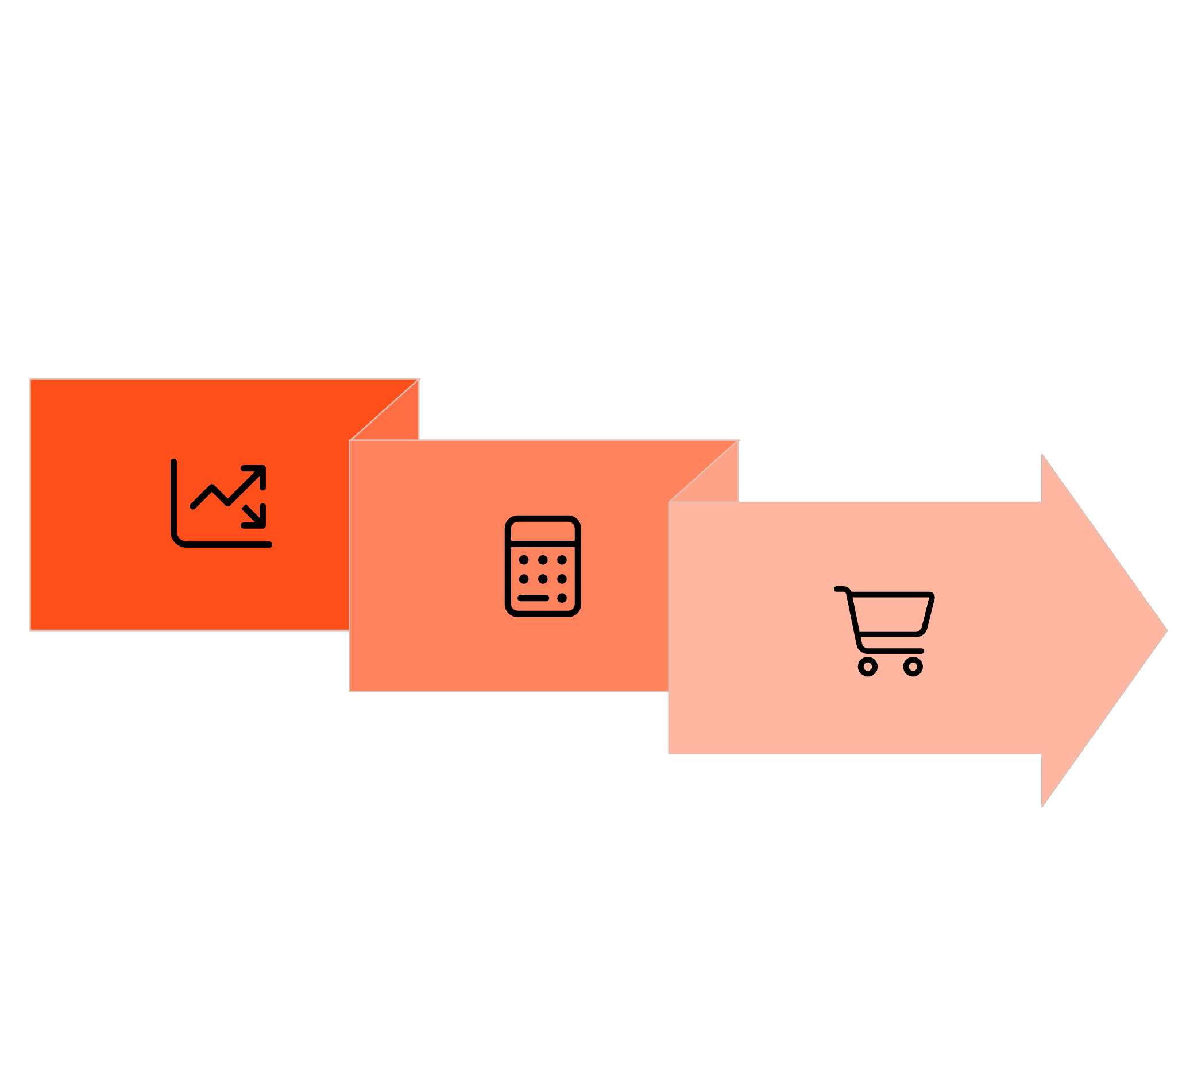



Project Approach: Purchase Order Generation
The final stage translates sales predictions into actionable ingredient orders.
Sales Forecast
Create Orders
Ingredient Calc
This systematic approach ensures that Domino's consistently has the right ingredients at the right time.

Slide 6

Detailed Purchase Order Workflow
1. Sales Forecasting
3. Purchase Order Creation
Utilize the trained model to predict pizza sales for the upcoming week. This forecast drives the entire procurement process.
Generate a detailed purchase order listing exact quantities for each ingredient, ready for submission to suppliers. This ensures efficient and timely procurement.
2. Ingredient Calculation
Based on predicted sales, precisely calculate the required quantities of each ingredient from the comprehensive ingredient dataset, minimizing waste.

